Slide 1
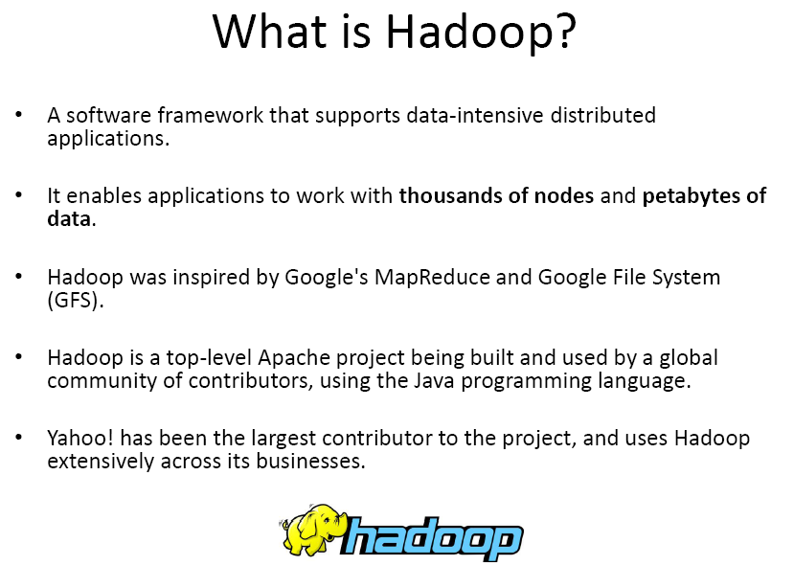
Hadoop

Slide 2
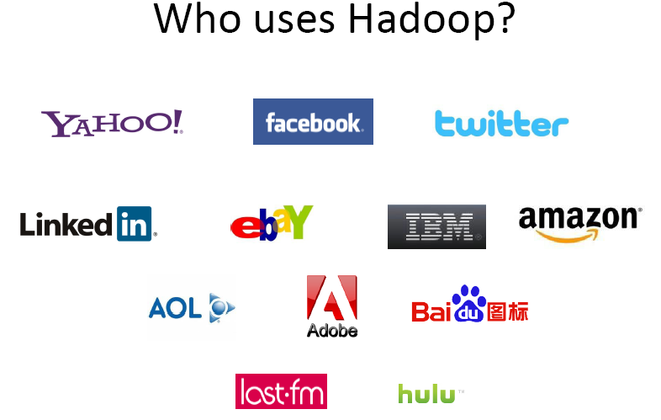
Hadoop

Slide 3
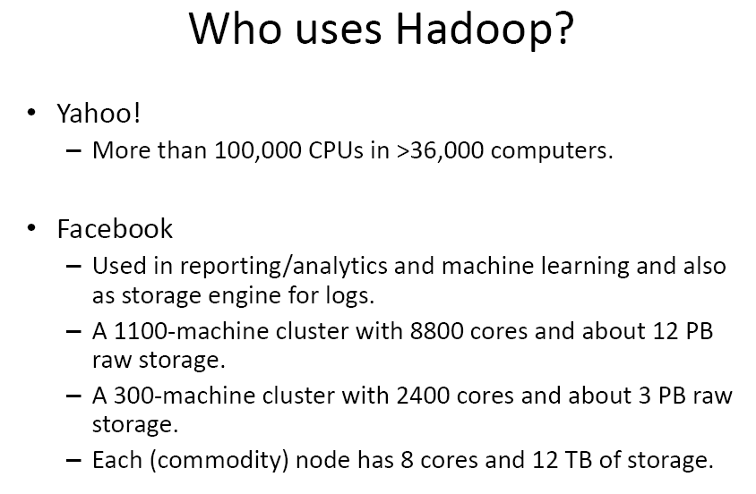
Hadoop

Slide 4
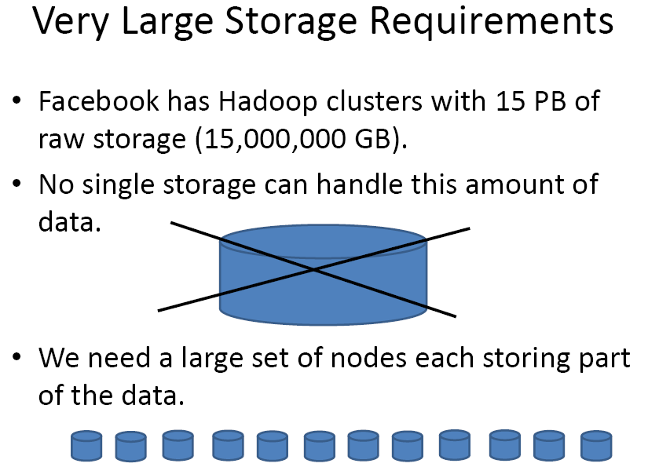
Hadoop

Slide 5
Introduction
Distributed programming framework.
Hadoop is an open source framework for writing and running distributed applications that process large amounts of data.
Key points of hadoop are
Accessible
Hadoop runs on large clusters of commodity machines or on cloud computing services such as Amazon’s Elastic Compute Cloud (EC2 ).
Robust
Because it is intended to run on commodity hardware, Hadoop is architected with the assumption of frequent hardware malfunctions. It can gracefully handle most such failures.
Scalable
Hadoop scales linearly to handle larger data by adding more nodes to the cluster.
Simple
Hadoop allows users to quickly write efficient parallel code.

Slide 6
Introduction
Hadoop consist of distributed file system, called HDFS.
The Hadoop Distributed File System (HDFS) is a distributed file system designed to run on commodity hardware.
HDFS is highly fault-tolerant and is designed to be deployed on low-cost hardware.
HDFS provides high throughput access to application data and is suitable for applications that have large data sets.
HDFS was originally built as infrastructure for the Apache Nutch web search engine project.
HDFS is part of the Apache Hadoop Core project.

Slide 7
Hadoop Daemons
Hadoop consist of five daemons.
NameNode
DataNode
Secondary nameNode
Job tracker
Task tracker
“Running Hadoop” means running a set of daemons, or resident programs, on the different servers in your network.
These daemons have specific roles; some exist only on one server, some exist across multiple servers.

Slide 8
Name Node
Hadoop employs a master/slave architecture for both distributed storage and distributed computation.
The distributed storage system is called the Hadoop File System, or HDFS.
The NameNode is the master of HDFS that directs the slave DataNode daemons to perform the low-level I/O tasks.
The NameNode is the bookkeeper of HDFS; it keeps track of how your files are broken down into file blocks, which nodes store those blocks, and the overall health of the distributed file system.
The function of the NameNode is memory and I/O intensive. As such, the server hosting the NameNode typically doesn’t store any user data or perform any computations for a MapReduce program to lower the workload on the machine.
it’s a single point of failure of your Hadoop cluster.
For any of the other daemons, if their host nodes fail for software or hardware reasons, the Hadoop cluster will likely continue to function smoothly or you can quickly restart it. Not so for the NameNode.

Slide 9
DataNode
Each slave machine in cluster host a DataNode daemon to perform work of the distributed file system, reading and writing HDFS blocks to actual files on the local file system.
Read or write a HDFS file, the file is broken into blocks and the NameNode will tell your client which DataNode each block resides in.
Job communicates directly with the DataNode daemons to process the local files corresponding to the blocks.
Furthermore, a DataNode may communicate with other DataNodes to replicate its data blocks for redundancy.

Slide 10
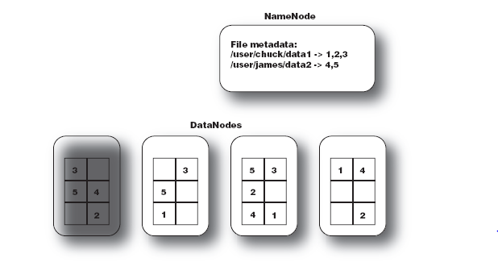
DataNode

Slide 11
DataNode
DataNodes are constantly reporting to the NameNode.
Upon initialization, each of the DataNodes informs the NameNode of the blocks it’s currently storing.
After this mapping is complete, the DataNodes continually poll the NameNode to provide information regarding local changes as well as receive instructions to create, move, or delete blocks from the local disk.

Slide 12
Secondary NameNode
The Secondary NameNode (SNN) is an assistant daemon for monitoring the state of the cluster HDFS.
Like the NameNode, each cluster has one SNN.
No other DataNode or TaskTracker daemons run on the same server.
The SNN differs from the NameNode, it doesn’t receive or record any real-time changes to HDFS.
Instead, it communicates with the NameNode to take snapshots of the HDFS metadata at intervals defined by the cluster configuration.
As mentioned earlier, the NameNode is a single point of failure for a Hadoop cluster, and the SNN snapshots help minimize the downtime and loss of data.
Nevertheless, a NameNode failure requires human intervention to reconfigure the cluster to use the SNN as the primary NameNode.

Slide 13
JobTracker
The JobTracker daemon is the liaison (mediator) between your application and Hadoop.
Once you submit your code to your cluster, the JobTracker determines the execution plan by determining which files to process, assigns nodes to different tasks, and monitors all tasks as they’re running.
Should a task fail, the JobTracker will automatically re launch the task, possibly on a different node, up to a predefined limit of retries.
There is only one JobTracker daemon per Hadoop cluster.
It’s typically run on a server as a master node of the cluster

Slide 14
Task tracker
Job Tracker is the master overseeing the overall execution of a Map-Reduce job.
Task Trackers manage the execution of individual tasks on each slave node.
Each Task Tracker is responsible for executing the individual tasks that the Job Tracker assigns.
Although there is a single Task Tracker per slave node, each Task Tracker can spawn multiple JVMs to handle many map or reduce tasks in parallel.

Slide 15
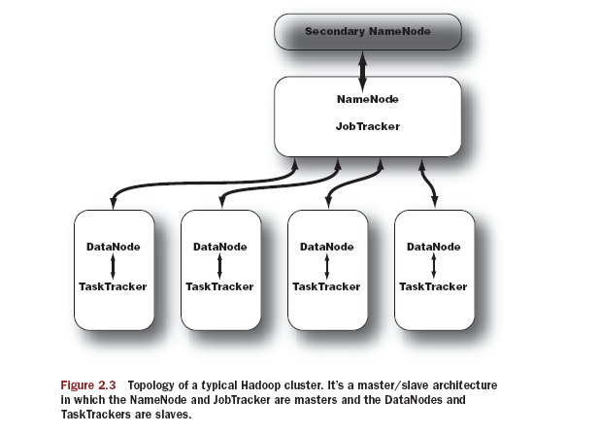
Hadoop Master/Slave Architecture

Slide 16
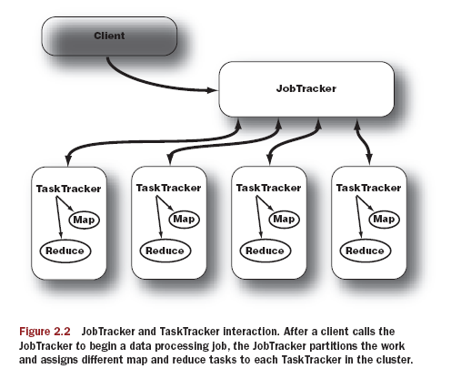
Master/slave Architecture

Slide 17
Hadoop Configuration Modes
Local (standalone) mode
The standalone mode is the default mode for Hadoop.
Hadoop chooses to be conservative and assumes a minimal configuration. All XML (Configuration) files are empty under this default mode.
With empty configuration files, Hadoop will run completely on the local machine.
Because there’s no need to communicate with other nodes, the standalone mode doesn’t use HDFS, nor will it launch any of the Hadoop daemons.
Its primary use is for developing and debugging the application logic of a Map-Reduce program without the additional complexity of interacting with the daemons.

Slide 18
Hadoop Configuration Modes
Pseudo-distributed mode
The pseudo-distributed mode is running Hadoop in a “cluster of one” with all daemons running on a single machine.
This mode complements the standalone mode for debugging your code, allowing you to examine memory usage, HDFS input/output issues, and other daemon interactions.
Need Configuration on XML Files hadoop/conf/.

Slide 19
Hadoop Configuration Modes
Configuration
core-site.xml
<?xml version="1.0"?> <?xml-stylesheet type="text/xsl" href="configuration.xsl"?>
<!-- Put site-specific property overrides in this file. -->
<configuration>
<property> <name>fs.default.name</name> <value>hdfs://localhost:9000</value> <description>The name of the default file system. A URI whose scheme and authority determine the FileSystem implementation. </description>
</property>
</configuration>
mapred-site.xml
<?xml version="1.0"?> <?xml-stylesheet type="text/xsl" href="configuration.xsl"?>
<!-- Put site-specific property overrides in this file. -->
<configuration>
<property> <name>mapred.job.tracker</name> <value>localhost:9001</value> <description>The host and port that the MapReduce job tracker runs at.</description>
</property>
</configuration>
hdfs-site.xml
<?xml version="1.0"?> <?xml-stylesheet type="text/xsl" href="configuration.xsl"?>
<!-- Put site-specific property overrides in this file. -->
<configuration>
<property> <name>dfs.replication</name> <value>1</value> <description>The actual number of replications can be specified when the file is created.</description>
</property>
</configuration>

Slide 20
Hadoop Configuration Modes
Fully distributed mode
Benefits of distributed storage and distributed computation
master—The master node of the cluster and host of the NameNode and Job-Tracker daemons
backup—The server that hosts the Secondary NameNode daemon
hadoop1, hadoop2, hadoop3, ...—The slave boxes of the cluster running both DataNode and TaskTracker daemons

Slide 21
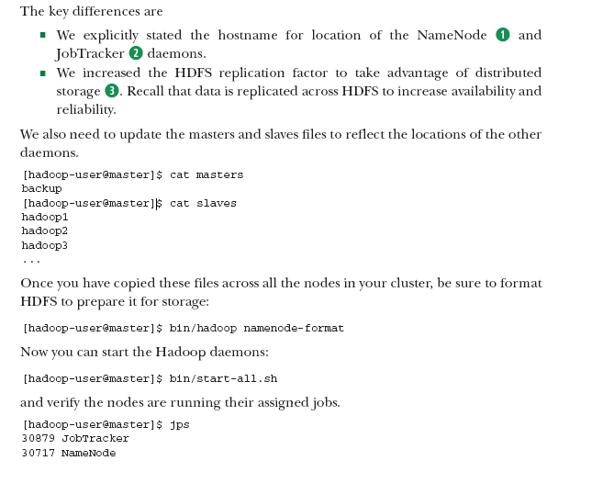

Slide 22
Working with files in HDFS
HDFS is a file system designed for large-scale distributed data processing under frameworks such as Map-Reduce.
Store a big data set of (say) 100 TB as a single file in HDFS.
Replicate the data for availability and distribute it over multiple machines to enable parallel processing.
HDFS abstracts these details away and gives you the illusion that you’re dealing with only a single file.
Hadoop Java libraries for handling HDFS files programmatically.

Slide 23
Hadoop Shell commands (Basic file commands )
Basic file commands
Hadoop file commands take the form of
hadoop fs -cmd <args>
hadoop fs –ls (list the hdfs content)
hadoop fs –mkdir /user/hdfs/test (make directory)
hadoop fs –rmr /user/hdfs/test (delete directory/files)
hadoop fs -cat example.txt | head
hadoop fs –copyFromLocal Desktop/test.txt /user/hdfs/
hadoop fs –copyToLocal /user/hdfs/test.txt Desktop/
Etc…

Slide 24
Assumptions and Goals
Hardware Failure
Hardware failure is the norm rather than the exception.
An HDFS instance may consist of hundreds or thousands of server machines, each storing part of the file system’s data.
The fact that there are a huge number of components and that each component has a non-trivial probability of failure means that some component of HDFS is always non-functional.
Therefore, detection of faults and quick, automatic recovery from them is a core architectural goal of HDFS.

Slide 25
Assumptions and Goals
Streaming Data Access
Applications that run on HDFS need streaming access to their data sets.
They are not general purpose applications that typically run on general purpose file systems.
HDFS is designed more for batch processing rather than interactive use by users.
The emphasis is on high throughput of data access rather than low latency of data access.

Slide 26
Assumptions and Goals
Large Data Sets
Applications that run on HDFS have large data sets.
A typical file in HDFS is gigabytes to terabytes in size. Thus, HDFS is tuned to support large files.
It should provide high aggregate data bandwidth and scale to hundreds of nodes in a single cluster.
It should support tens of millions of files in a single instance

Slide 27
Assumptions and Goals
Simple Coherency Model
HDFS applications need a write-once-read-many access model for files.
A file once created, written, and closed need not be changed.
This assumption simplifies data coherency issues and enables high throughput data access.
A Map/Reduce application or a web crawler application fits perfectly with this model.
There is a plan to support appending-writes to files in the future.

Slide 28
Assumptions and Goals
“Moving Computation is Cheaper than Moving Data”
A computation requested by an application is much more efficient if it is executed near the data it operates on.
This is especially true when the size of the data set is huge. This minimizes network congestion and increases the overall throughput of the system.
The assumption is that it is often better to migrate the computation closer to where the data is located rather than moving the data to where the application is running.
HDFS provides interfaces for applications to move themselves closer to where the data is located.

Slide 29
Assumptions and Goals
Portability Across Heterogeneous Hardware and Software Platforms
HDFS has been designed to be easily portable from one platform to another.
This facilitates widespread adoption of HDFS as a platform of choice for a large set of applications.

Slide 30
Assignment
Interrelation between hadoop and Amazon cloud.

Slide 31
Q&A/Feedback?

